Slide 1


Devops

Slide 2

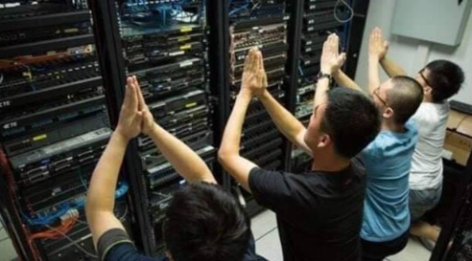
Pain Area in Product Development
Manual Processes
Ticket based changes
Hard to build new environments
Slow delivery
Inconsistent change frequency
Big releases
Poor change failure rates, with mistakes repeating
Poor alerting
Inconsistent Hardening with mistakes repeating
Security overlooked for fast deployments

Slide 3

Result
Silos – continuous fight between development and Support teams
Us vs them
Poor Customer Satisfaction
Revenue decline
No innovation
Best employee leave
Knowledge waste , waiting waste and efforts waste

Slide 4
A New Company - Devsoft
Development
Project Management
Architecture
Business Analysis
Quality Assurance
Information Security
Operations

Slide 5
Devops - A cultural shift
A DevOps team includes developers and IT operations working collaboratively
throughout the product lifecycle, in order to increase the speed and
quality of software deployment.
Under a DevOps model, development and operations teams are no longer “siloed.” Sometimes,
these two teams merge into a single team where the engineers work across the entire
application lifecycle — from development and test to deployment and
operations — and have a range of multidisciplinary skills.

Slide 6
What is Devops ?
DevOps is a set of practices, tools, and a cultural philosophy that automate and integrate the processes between software development and IT teams. It emphasizes team empowerment, cross-team communication and collaboration, and technology automation.

Slide 7
Course Objective
Learn the Devops tool stack used in industry
Be able to setup production ready Devops CI/CD pipelines.

Slide 8
Couse benefits
People who want to shift from other technologies
People who are willing to move onto DevOps Culture

Slide 9
Tools covered
Git/Github - Version Control System
Jenkins - Continuous Integration
Maven - Build Tool
SonarQube - Code Analysis
Docker/Kubernetes - Containerization
Ansible - Deployment and Configuration Management
Azure - Infrastructure
Prometheus - Monitoring and Alerting

Slide 10
Training does not cover
Any Programming Language
Any expert level tool functioning

Slide 11

What was being used before Devops ?
Waterfall Model
Agile Model
And others like Spiral,Scrum and Lean

Slide 12
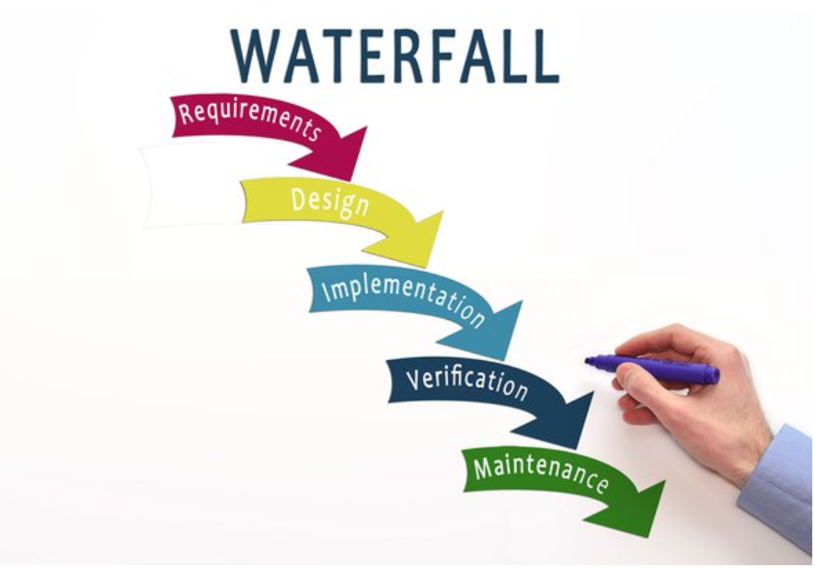
Waterfall model

Slide 13
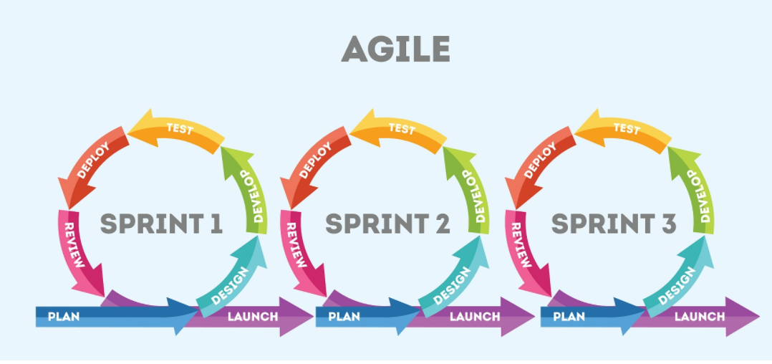
Agile model

Slide 14
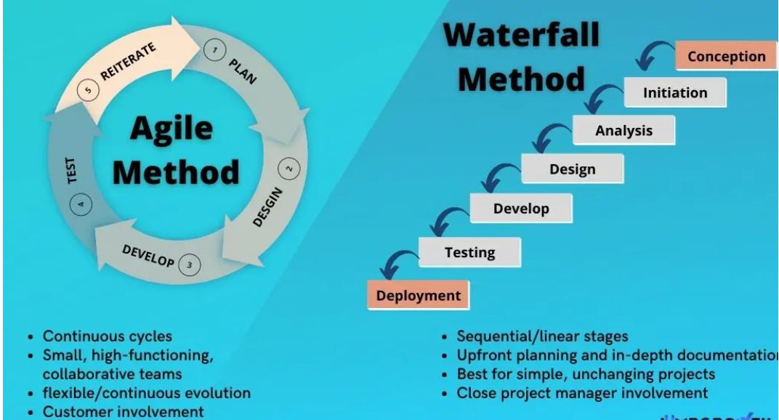
Waterfall vs Agile model

Slide 15
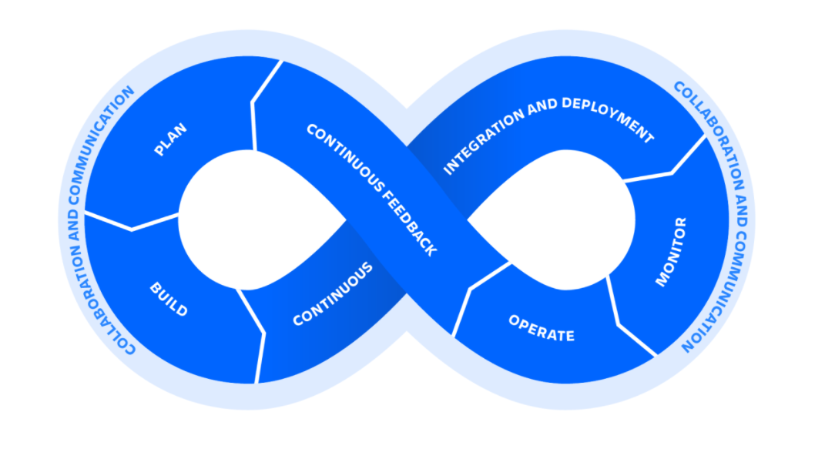
The Devops Cycle
Devops isn't any single person's job. It's everyone's job.

Slide 16

The Devops Tools

Slide 17

DevOps delivery Pipeline
Project/task Management
Development and Configuration
Source Code Repository
Compile
Unit test
Packaging
Server Provisioning
Load Performance Testing
Ready to Release
Server1
Server2
Server3

Slide 18
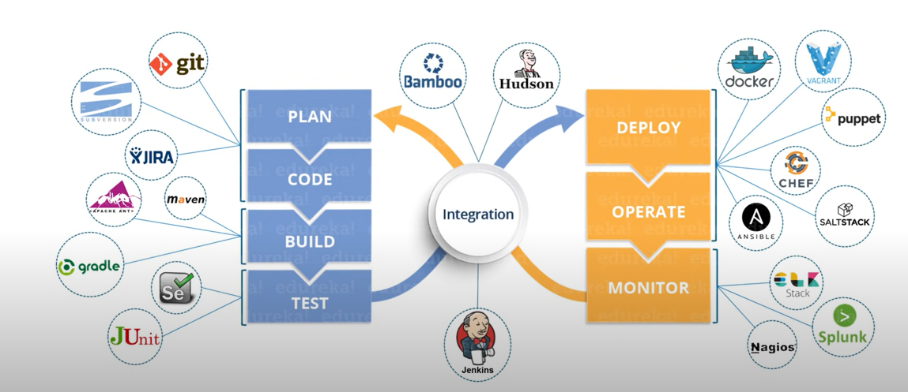
The Devops Tools

Slide 19













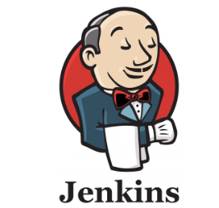

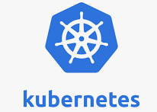

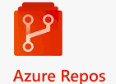













DevOps Toolset
Monitoring
Compile
Unit test/Static Analysis
Packaging/Artifacts
Application Performance
Monitoring
Production Environment
CI/CD Stage
Source Code Repo
Performance Load Testing
Environment Provisioning
Sign Off
Development and Config
Ready to release Software
Acceptance Test
Project/Task management

Slide 20
Version Control System
Purpose: Manage changes to source code over time, track history, and facilitate collaboration among developers.
Types:
Centralized Version Control Systems (CVCS): Single central repository (Subversion).
Distributed Version Control Systems (DVCS): Each developer has a full copy of the repository (Git).

Slide 21
Version Control System
Key Features:
Branching and Merging: Allows parallel development and integration of changes.
Commit History: Tracks changes with timestamps, author information, and commit messages.
Conflict Resolution: Tools to resolve conflicts when multiple changes overlap.
Version Tags: Mark significant points in history (e.g., releases or milestones).

Slide 22

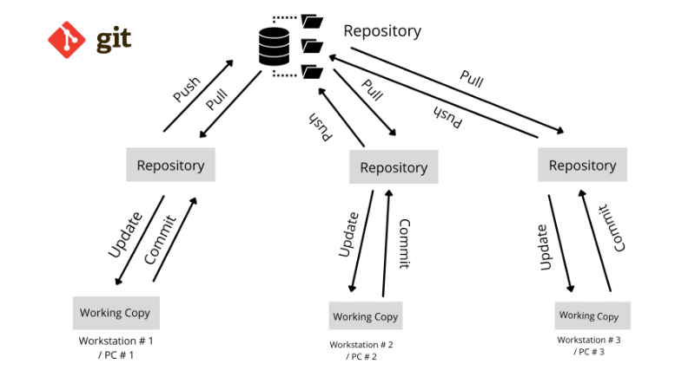
Distributed Version Control System

Slide 23
Git starts with Who AM I ?
Introduce Yourself
git config --global user.name “Ujjawal”
git config --global user.email mail.cloudblogger@gmail.com
git config --global credential.helper store
Validate
git config --list

Slide 24
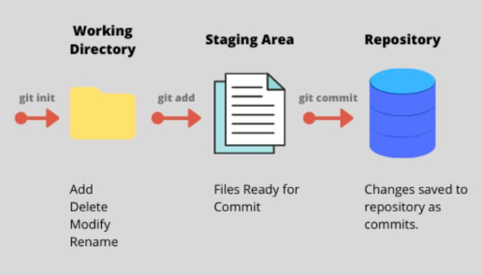
Git Stages

Slide 25
Some Important Git commands
1. git init
- Initializes a new Git repository in the current directory.
2. git clone <repository>
- Copies an existing Git repository from a remote server to your local machine.
3. git status
- Displays the state of the working directory and the staging area. Shows which changes have been staged, which haven't, and which files are not being tracked by Git.
4. git add <file>
- Adds a file to the staging area, preparing it for a commit.
5. git commit -m "<message>"
- Records changes to the repository with a descriptive message.

Slide 26
Some Important Git commands
Working on remote repository
1. git remote add <name> <url>
- Adds a new remote repository with a specified name and URL.
2. git remote -v
- Lists all remote repositories associated with the local repository.
3. git push <remote> <branch>
- Pushes commits from the local branch to the remote repository.
4. git pull <remote> <branch>
- Fetches and integrates changes from the remote branch to the local branch.

Slide 27
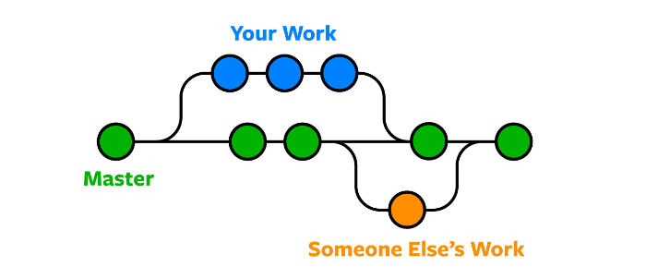
Why Git Branches
Git allows for the creation of new branches for separate tasks, enabling users to switch between different tasks easily with commands such as 'git status' and 'git branch'.
Users can create a new branch in Git by running the 'git checkout -b my-branch-name' command, where 'my-branch-name' can be replaced with the desired name.
To switch between local branches, the 'git checkout my-branch-name' command is used. For branches from a remote repository, the 'git checkout --track origin/my-branch-name' command is utilized.

Slide 28
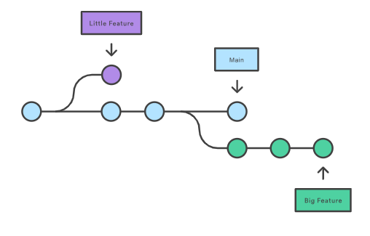
Git Branches
Git branch <new-branch> Git branch –d <new-branch>
Git checkout <new-branch> Git branch –M <Newest-branch>
Git checkout –b <new-branch> Git branch –r
Git checkout --track origin/my-branch-name

Slide 29
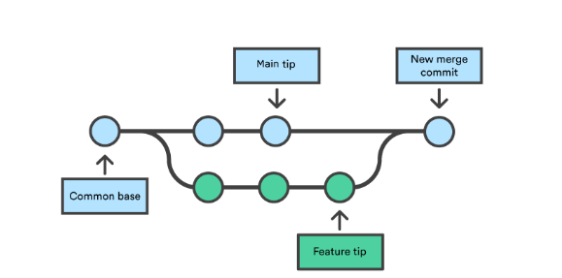
Git Merge

Slide 30
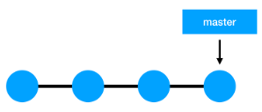
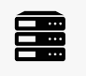
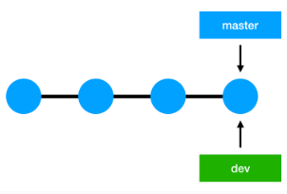
Git Merge

Slide 31
Git Merge
# Start a new feature
git checkout -b new-feature main
# Edit some files
git add <file>
git commit -m "Start a feature“
# Merge in the new-feature branch
git checkout main
git merge new-feature
git branch -d new-feature

Slide 32
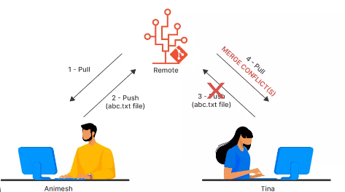
Git Conflict

Slide 33
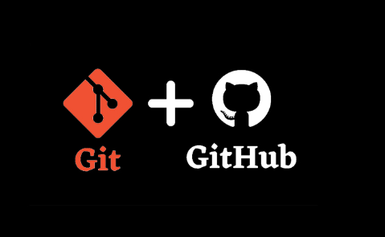
Git + GitHub

Slide 34
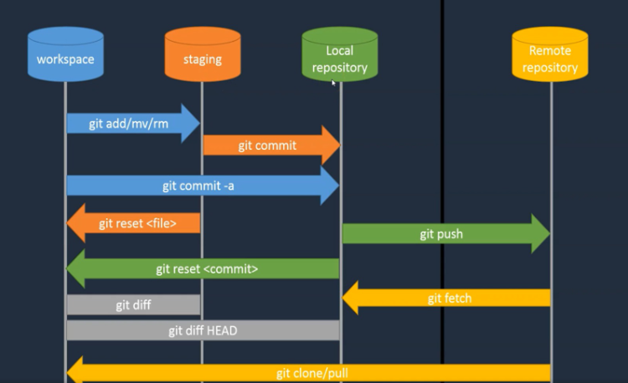
GitHub

Slide 35
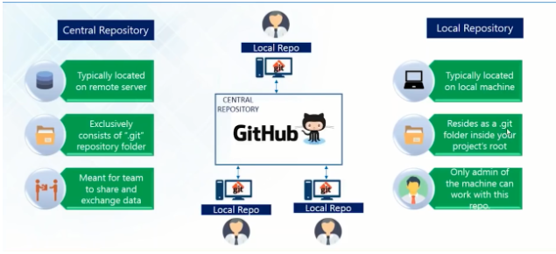
GitHub

Slide 36
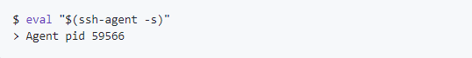
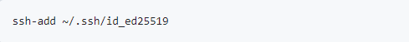
GitHub – Adding SSH key
Refer the below Link :
https://docs.github.com/en/authentication/connecting-to-github-with-ssh/
generating-a-new-ssh-key-and-adding-it-to-the-ssh-agent?platform=windows

Slide 37
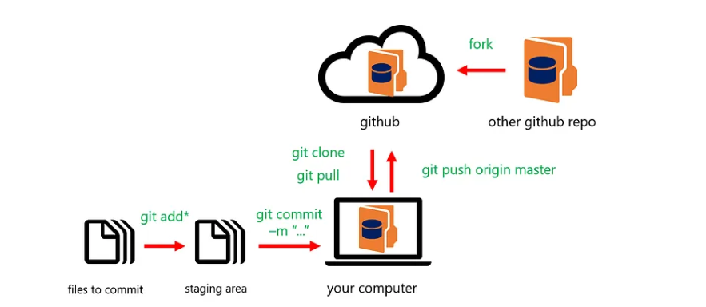
How they work together

Slide 38
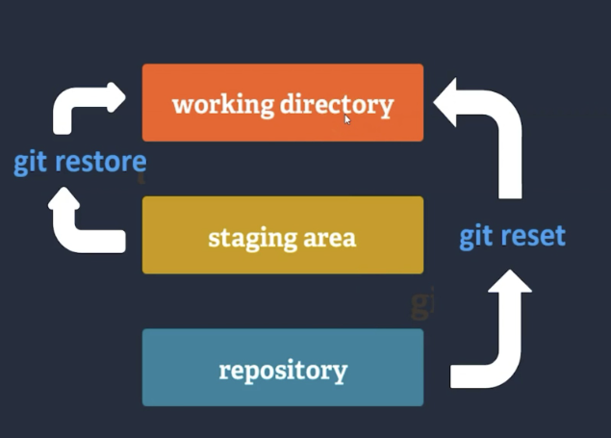
How to reload, revert, reset
Revert Changes from working directory
git restore <file>
git checkout -- <file>
Revert Changes from Staging Area
git restore --staged <file>
git restore <file>
Revert Changes from Local Repository
git reset <commit-id> or git revert -m 1 <commit-id>
git restore <file>
Revert Changes from Remote Repository
We don’t have a direct way to do it

Slide 39
Sample Project
Create 3 branches (Prod, Pre-prod and Dev)
Add team as collaborators to this repository.
Enable SSH based authentication
Protect Prod and Pre-prod branches
1 approval needed to check-in code on Pre-prod and 2 approvals needed to check-in code on to Prod
Build and Deploy should be successful before code is checked into UAT as well as Prod

Slide 40

MAVEN

Slide 41
What we will cover ?
How a developer uses Maven
Activities of a DevOps Engineer on Maven
Build projects on Maven
Setup and Integration of Maven with Jenkins

Slide 42
Prepare Environment
Install Java
Install Eclipse
Create 1st Maven Project
Maven Coordinates
Default Directory Structure
Steps Involved in Building a Java Project
Maven Goals
Build first Maven Project

Slide 43
Maven Goals and Repositories
Pom.xml
Transitive Dependency
Maven Repositories
Push Maven Project onto GitHub

Slide 44
Maven Goals and Repositories
Prepare Maven Server
Setup Maven on Linux
Build Maven Project on Linux
Commonly Used Maven Goals
Create a Project with Maven Archetype
Settings.xml
Deploy an Application on Tomcat Server

Slide 45
Maven and DevOps Workflow
Setup Jenkins Server
Add Maven Server as an Agent to Jenkins
Build a Java Project on Agent (Maven Server)

Slide 46
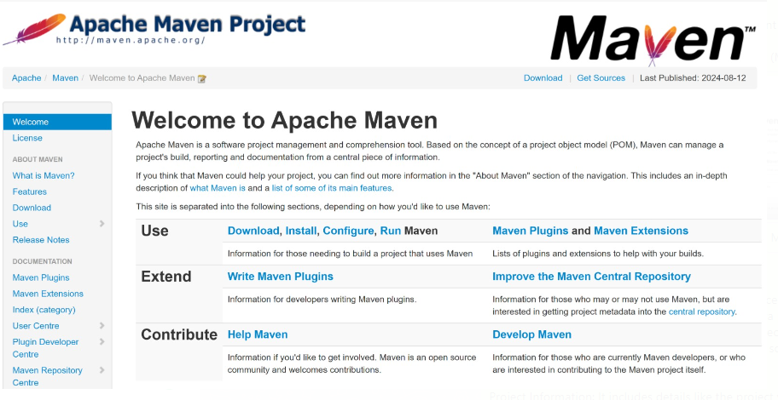
Maven

Slide 47
Build an Application
Compiling source code
App.java > App.class
AppTest.java > AppTest.class
Run the test
Packaging jar/ear/war files
Deploy to server

Slide 48
Maven Goals(Lifecycle)
Validate - validate the project is correct and all necessary information is available
Compile - compile the source code of the project
Test - test the compiled source code using a suitable unit testing framework.
These tests should not require the code be packaged or deployed
Package - take the compiled code and package it in its distributable format, such as a JAR.
Verify - run any checks on results of integration tests to ensure quality criteria are met
Install - install the package into the local repository, for use as a dependency
in other projects locally
Deploy - done in the build environment, copies the final package to the
remote repository for sharing with other developers and projects.

Slide 49

Jenkins

Slide 50
Jenkins Introduction
What is Jenkins?
Jenkins is an open-source automation server.
Helps automate parts of software development related to building, testing,
and deploying, facilitating continuous integration (CI) and continuous delivery (CD).

Slide 51
Jenkins Introduction
Why use Jenkins?
Automates repetitive tasks.
Increases productivity and code quality.
Supports a wide range of plugins and integrations.

Slide 52
Jenkins Key Features
Cross-Platform: Runs on Windows, macOS, and Linux.
Easy Configuration: Web-based configuration interface.
Extensible: Over 1800 plugins for integrating with other tools.
Distributed Builds: Supports running multiple builds across different machines.

Slide 53
Jenkins Architecture
Master-Slave Architecture
Master: Coordinates the build process.
Slave (Agent): Executes the build jobs.
Pipeline Architecture
Pipeline as Code: Define your build process in a Jenkinsfile.
Stages and Steps: Structure your build process in stages and steps.

Slide 54
Install Jenkins
.
Prerequisites:
Java (JDK 8 or 11)
Hardware requirements
Installation on Linux/Windows/Mac:
Download Jenkins from the official website.
Install using package manager or installer.
Start Jenkins service.
Initial Setup:
Access Jenkins at http://localhost:8080
Unlock Jenkins using the initial admin password.
Install recommended plugins

Slide 55
THANKS

